Slide 1
Lecture 20
The Paired t test
Equivalence of Tests and Confidence Intervals
A Discrete Example

Slide 2
The Paired t Test
Matched-sample design:
  e.g. We want to compare 2 production methods.
  Paired:
  e.g. In a production experiment, each alloy is divided into 2 parts. Production method 1 is used on one part, and production method 2 is used on another part.
  Variation between alloys is eliminated as a source of sampling error.
  Before/after:
  e.g. In a production experiment, each worker first uses one production method and then uses production method 2.
  Variation between workers is eliminated as a source of sampling error.

Slide 3
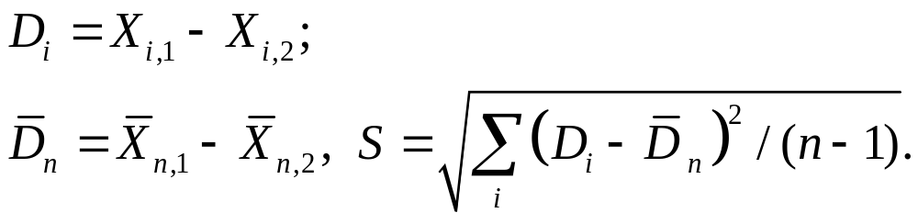
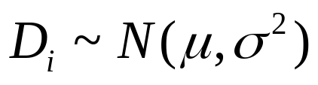
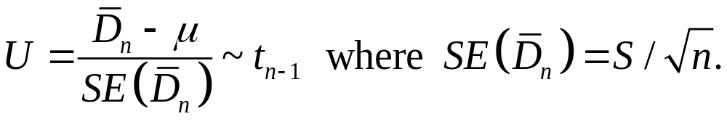
Consider
Assuming
then

Slide 4

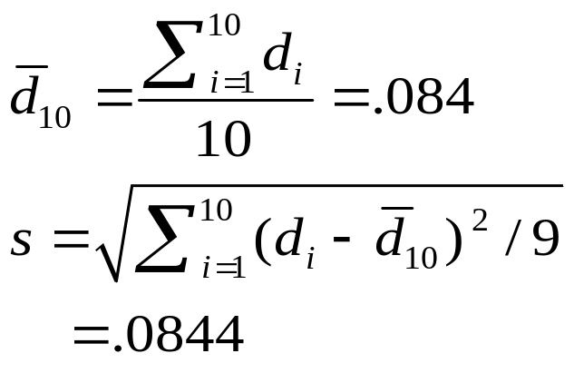
Paired t Test: Example
Assume you work in the finance department. Is the new financial package faster (0.05 level)? You collect the following data entry times:
User Current Leader (1) New Software (2) Difference D_{i}
C.B. 9.98 Seconds 9.88 Seconds .10
T.F. 9.88 9.86 .02
M.H. 9.84 9.75 .09
R.K. 9.99 9.80 .19
M.O. 9.94 9.87 .07
D.S. 9.84 9.84 .00
S.S. 9.86 9.87 - .01
C.T. 10.12 9.86 .26
K.T. 9.90 9.83 .07
S.Z. 9.91 9.86 .05

Slide 5
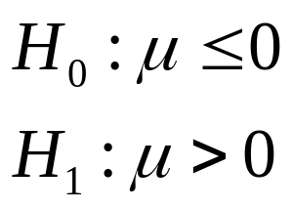

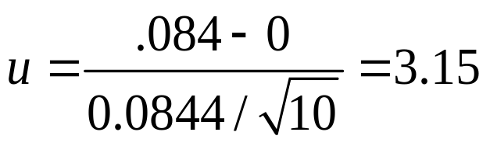
  Is the new financial package faster (0.05 level)?
Reject
A level α0 =.05 t test reject H0 if
α 0 =.05
1.8331
The test statistic is calculated as
Decision: Reject H₀
Conclusion: The new software package is faster.

Slide 6



Equivalence of Tests and Confidence Intervals
Suppose that a random sample X=(X1,…,Xn) is to be taken from a distribution that depends on an unknown parameter .
If a random set ω(X) satisfies
for every , we call ω(x) a coefficient γ confidence interval for θ.

Slide 7
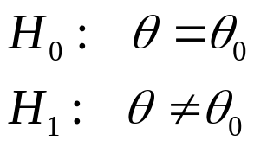

Hypothesis Test → Confidence Interval
Consider testing the hypotheses:
Suppose that for every point and every value of γ (0<γ<1), we can construct a level 1-γ test such that

Slide 8
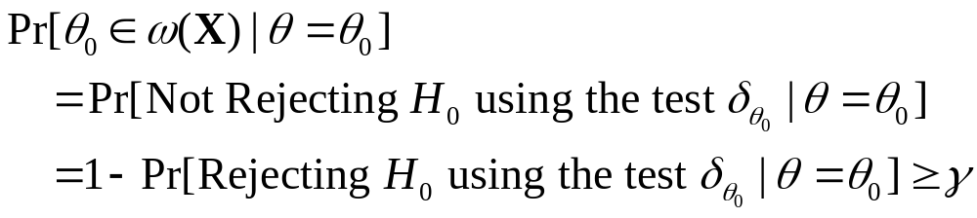
Hypothesis Test → Confidence Interval
For each possible set of values x=(x1,…,xn), let ω(x) denote the set of all points for which the test does not reject the hypothesis H0 when the observed data are X=x.

Slide 9


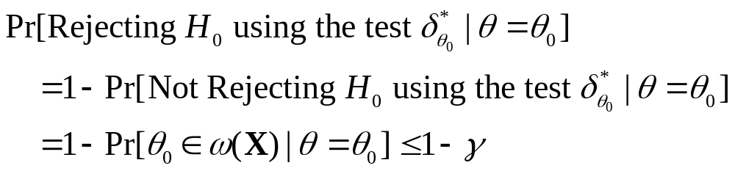
Confidence Interval → Hypothesis Test
Suppose that w(x) is a confidence interval for θ with confidence coefficient γ. Then for each point , define a test procedure as follows: not rejecting H0 if and only if
So is a level 1-γ test for every θ0.

Slide 10

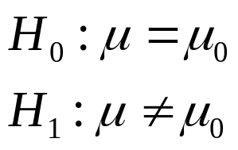
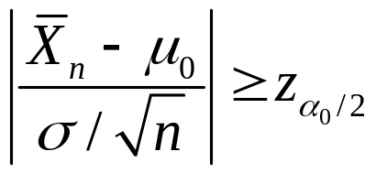
Example: A Confidence Interval for the Mean of a Normal Distribution
Suppose that X=(X1,…,Xn) is a random sample from a normal distribution with mean μ and known variance . Based on the observed value x, we need to construct a coefficient γ confidence interval for μ.
Let α0=1-γ . We have known that a level α0 test for testing the hypotheses
is to reject H0 if

Slide 11
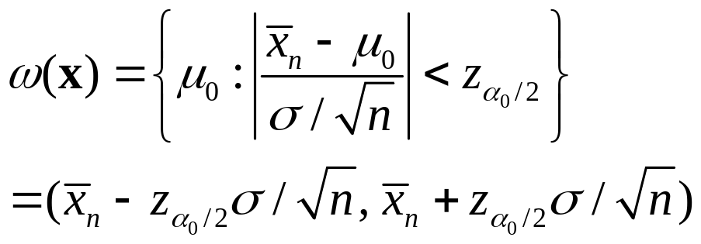
Example: A Confidence Interval for the Mean of a Normal Distribution
The equivalent confidence interval is

Slide 12
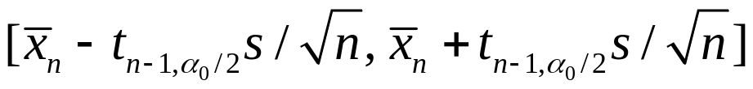
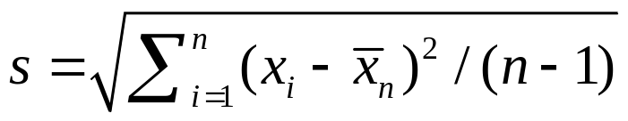
Example: Constructing a Test from a Confidence Interval
Suppose that X=(X1,…,Xn) is a random sample from a normal distribution with mean μ and variance both unknown. We have known that the coefficient γ confidence interval for μ is
where α0=1-γ, .

Slide 13
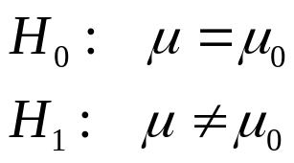
Example: Constructing a Test from a Confidence Interval
The equivalent α0=1-γ level test of the hypotheses
is to reject H0 if

Slide 14
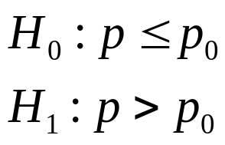
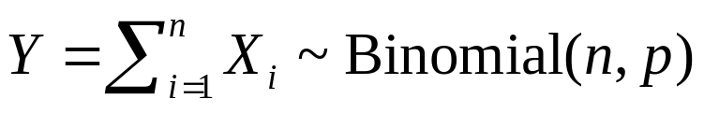

A Discrete Example
Suppose that X1,…,Xn are i.i.d. with Bernoulli distribution with parameter p. Suppose we wish to test the hypotheses:
Let . The larger p is, the larger we expect Y to be.
Our test is to reject H0 if for some c.

Slide 15
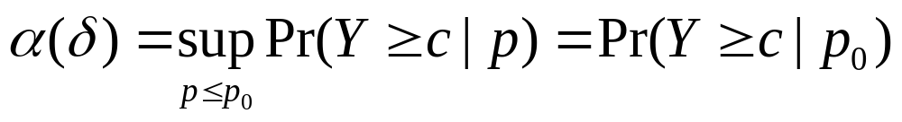

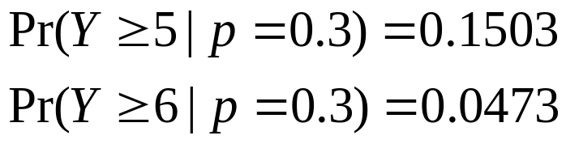
The Critical Value Approach
We want the size of the test
to be as close to α0 as possible without exceeding α0, so c would be the smallest number such that
E.g. n=10, p0=0.3, α0=0.1. Because
Any value of c in the interval (5,6] would be fine, because Y can only take integer values.

Slide 16
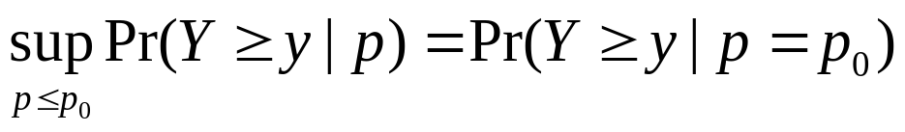

The p Value Approach
The p-value, when Y=y is observed, is
If p0=0.3, n=10, Y=6,
so the p-value is 0.0473, and the null hypothesis H0 would be rejected for any α0>0.0473.

Slide 17
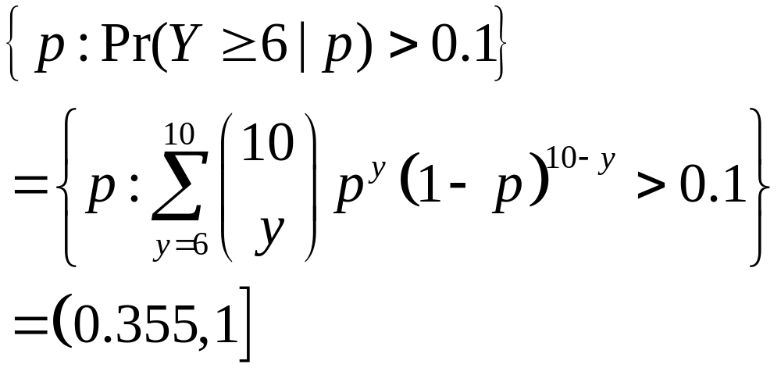
The 90% Confidence Interval
Suppose n=10 and Y=6. The equivalent confidence interval is

